Slide 1

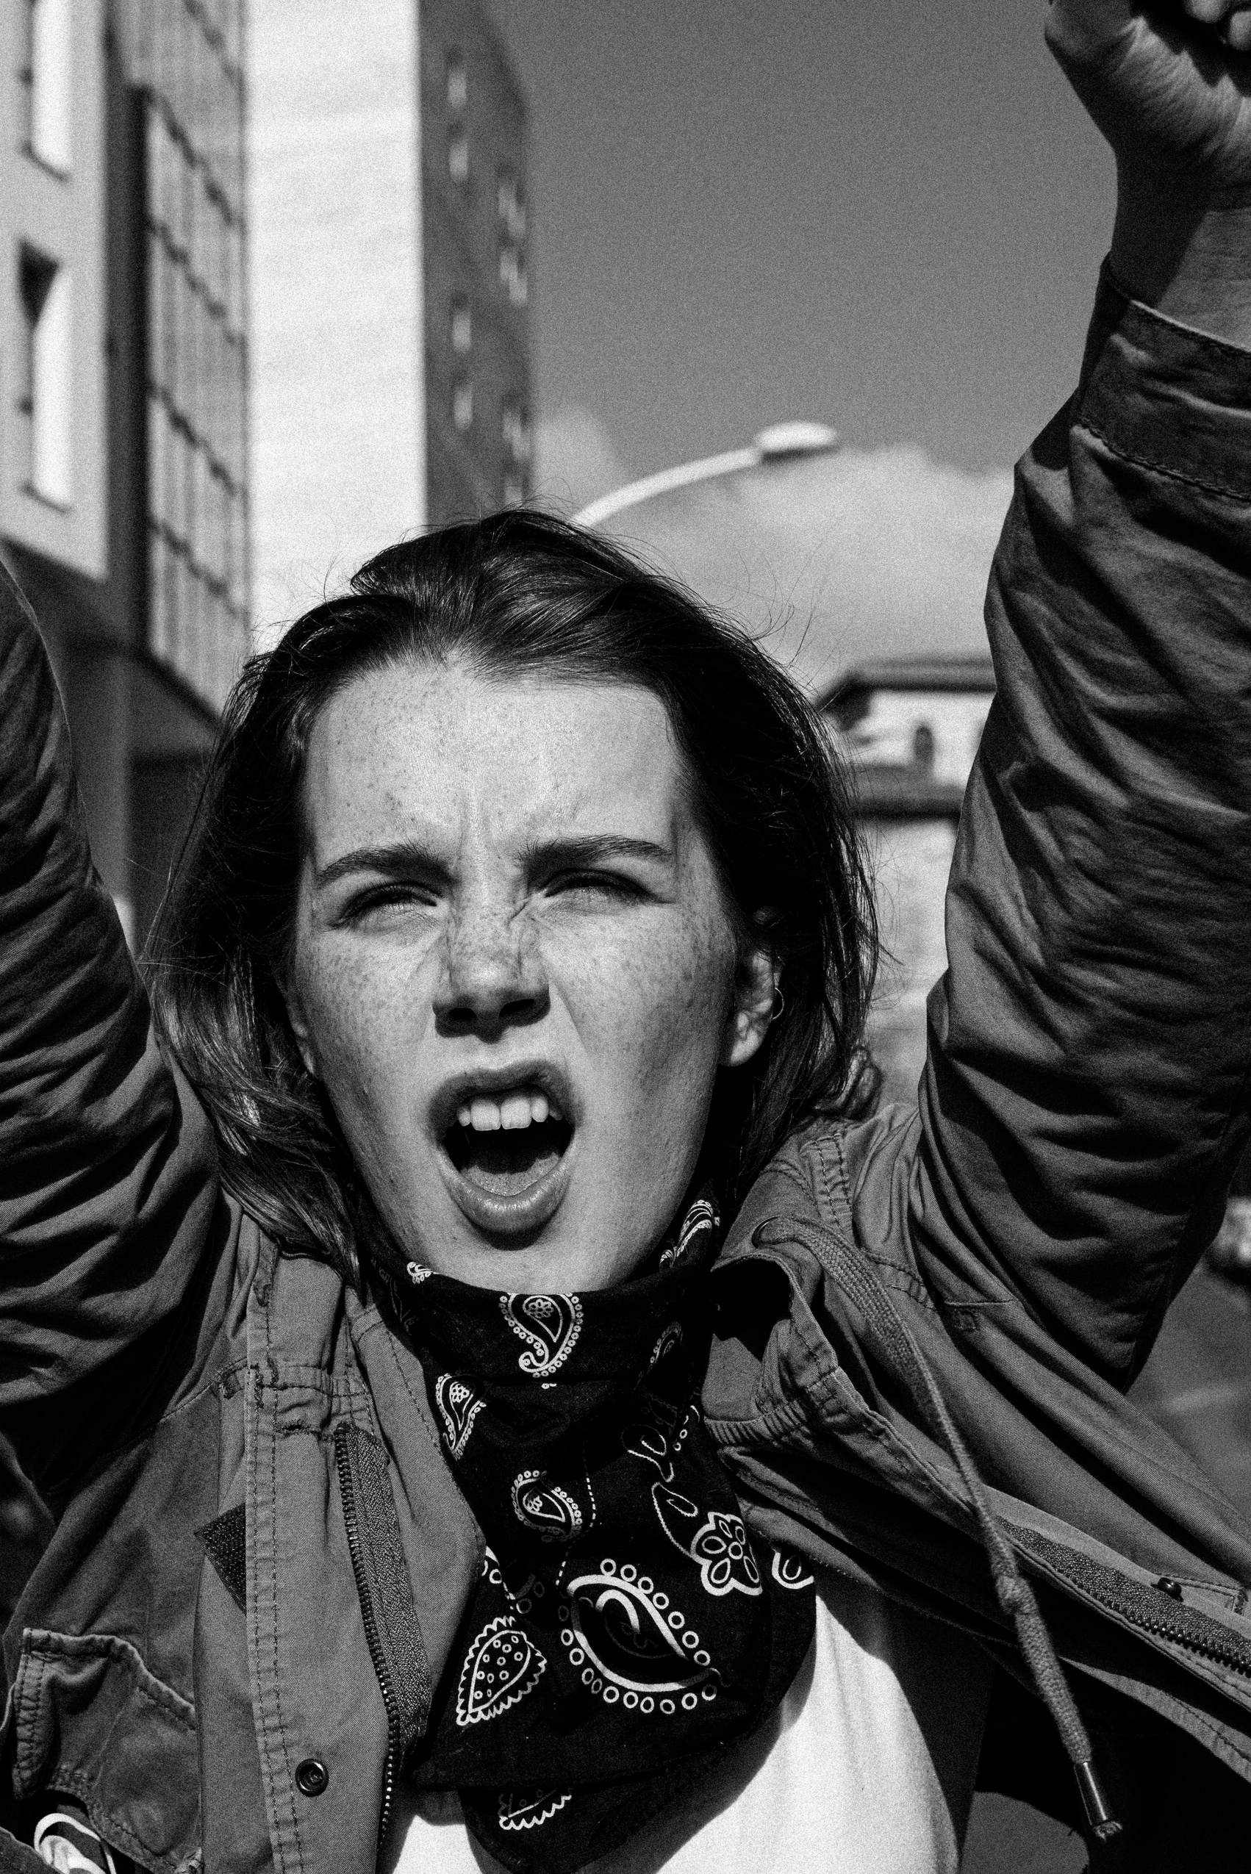
AFRICAN SKILLED YOUTH ADVOCACY FOR SUSTAINABLE DEVELOPMENT
WHAT TEENAGERS NEED TO KNOW ABOUT
GENDER-BASED VIOLENCE (GBV)
UNDERSTANDING, RECOGNISING,AND PREVENTING GBV
PRESENTED BY : DR. YEWANDE OMIKUNLE-OGUNBIYI
JULY 5TH 2025

Slide 2
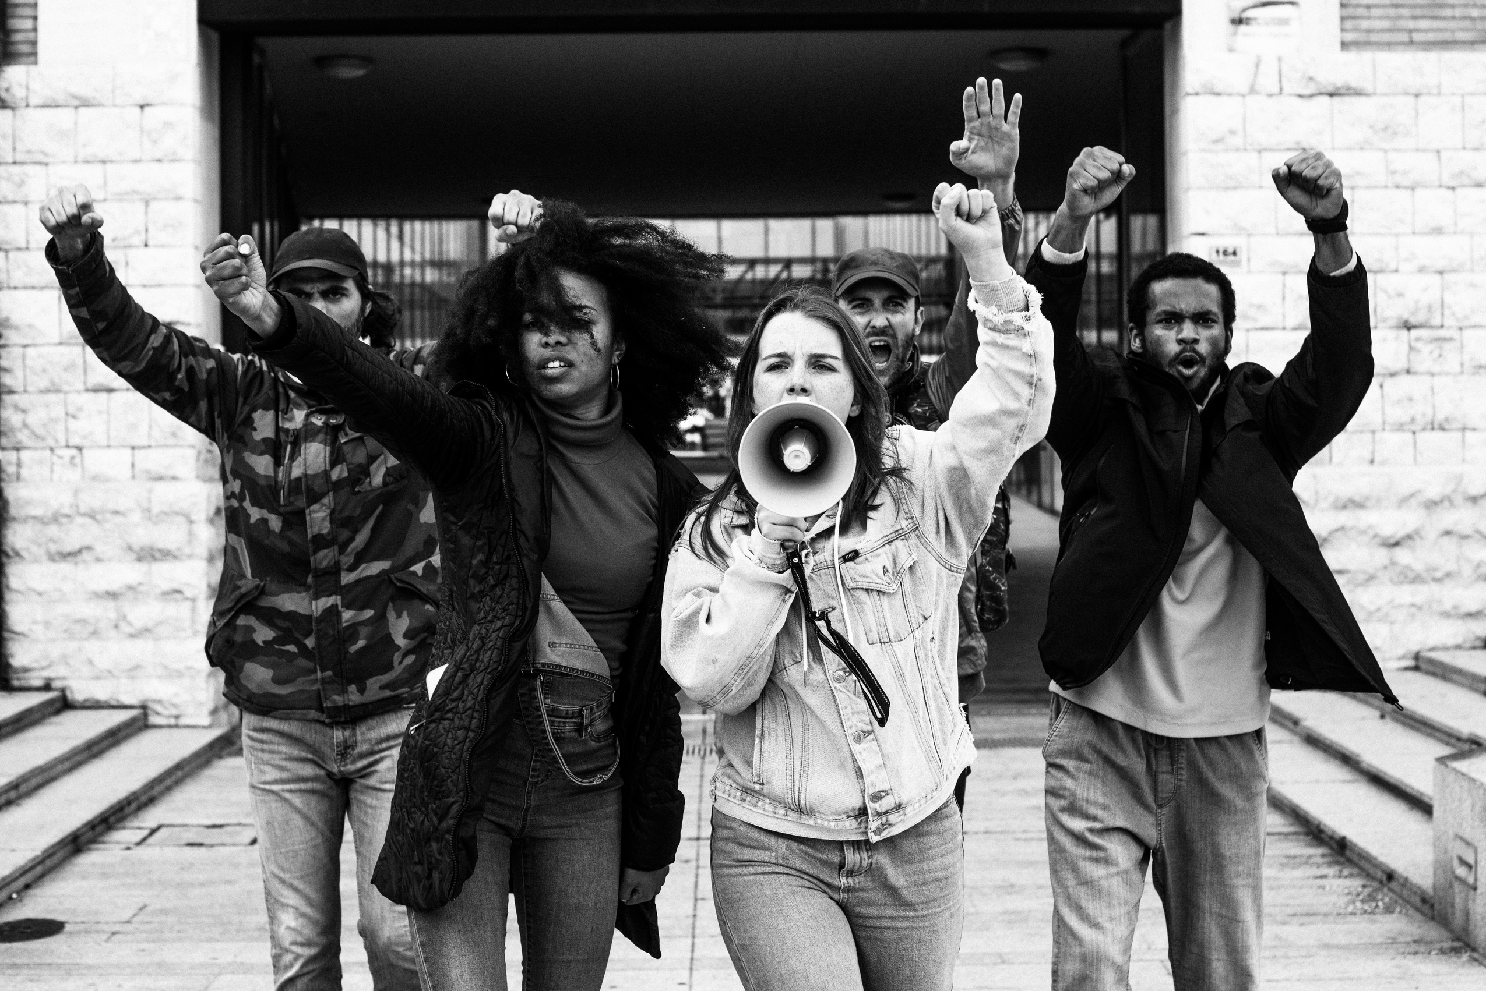
WHAT IS GENDER-BASED VIOLENCE (GBV)?
GBV refers to harmful acts directed at individuals based on their gender. It includes physical, sexual, emotional, and psychological abuse,
Examples: domestic violence, sexual harassment, rape, forced marriage, online harassment

Slide 3
ROOT CAUSES OF GBV
Male dominance and unequal power relationships
Harmful societal norms and stereotypes
Desire to assert control and power over others

Slide 4
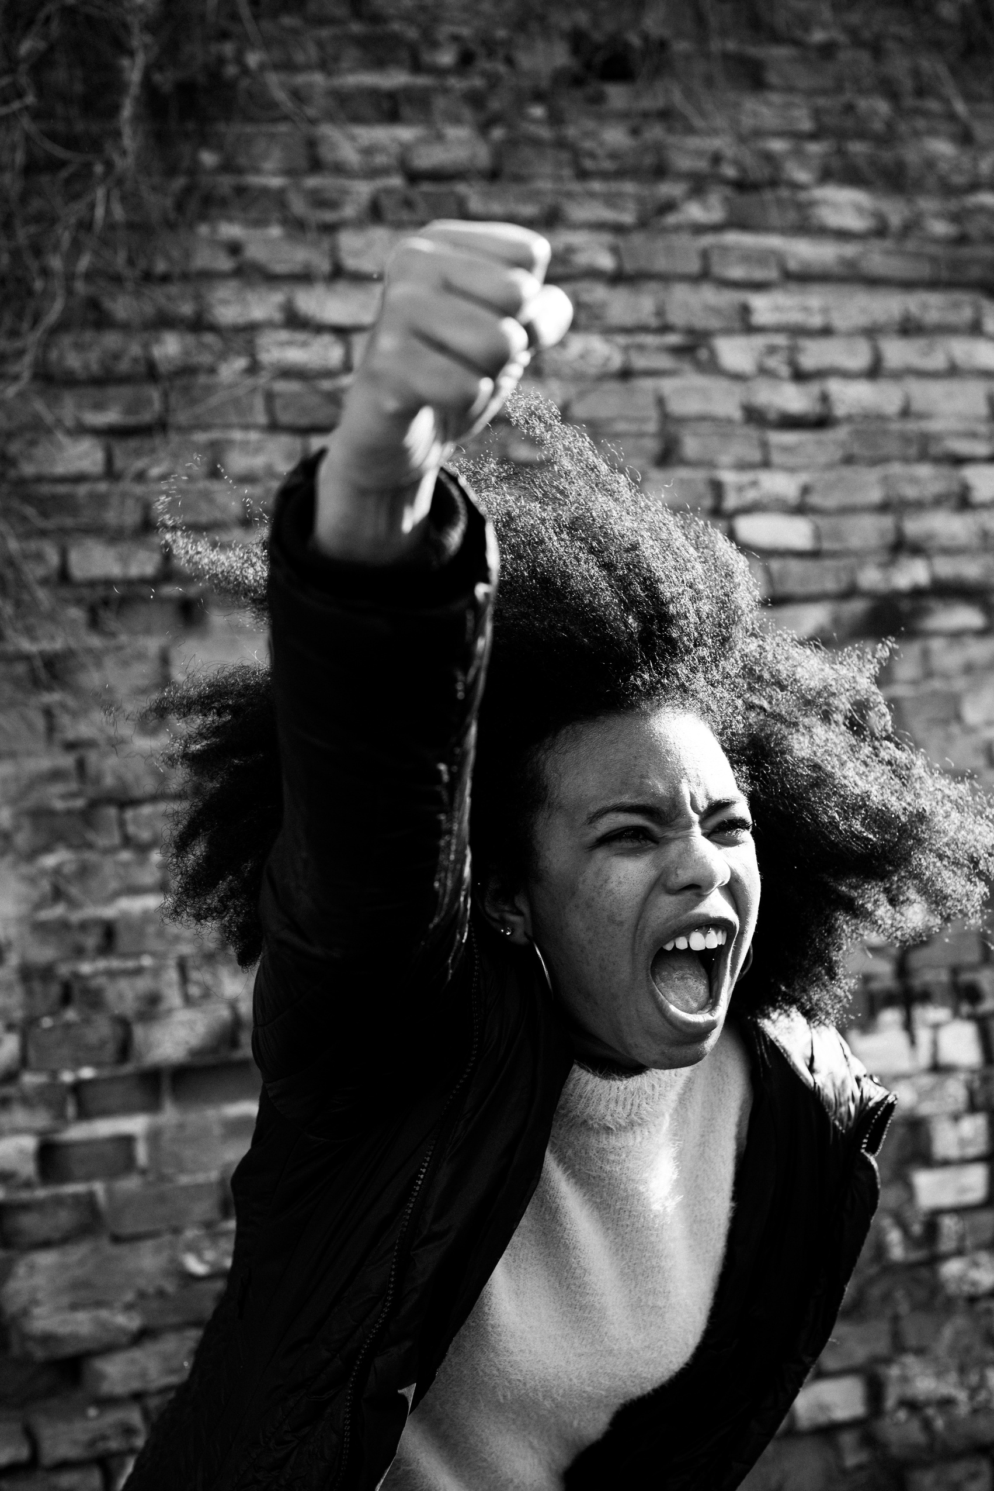
WHO IS AFFECTED BY GBV?
  Anyone can be a victim, but women and girls are disproportionately affected
  The majority of perpetrators are boys and men
  Higher risks for marginalised groups: people with disabilities, racialised communities, LGBTQI+, Indigenous people, and youth under 25

Slide 5
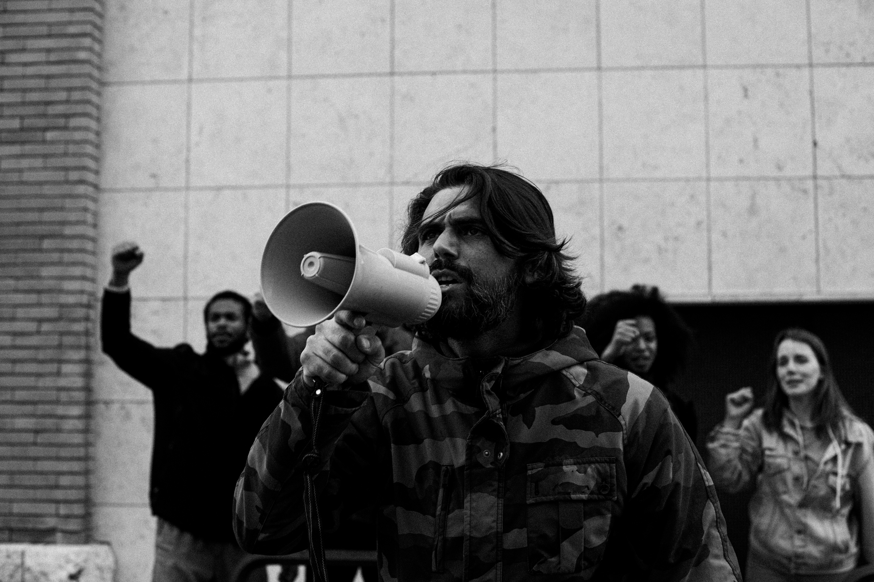
RECOGNIZING AND INTERRUPTING HARMFUL BEHAVIOR
  Stop Victim Blaming: Violence is never the victim's fault
  Interrupt Sexist and Discriminatory Language: Speak up against harassment and abuse
  Develop an Action Plan: Know how to respond when witnessing abuse

Slide 6
THE IMPACT OF GBV
  UNDERMINES HEALTH, DIGNITY, SECURITY, AND AUTONOMY
  CAUSES PHYSICAL AND EMOTIONAL HARM
  LEADS TO CONSEQUENCES LIKE UNWANTED PREGNANCIES AND SEXUALLY TRANSMITTED INFECTIONS

Slide 7


TAKING ACTION AGAINST GBV
EDUCATE YOURSELF ON GBV'S ROOT CAUSES AND MYTHS
CHALLENGE SOCIETAL NORMS THAT CONDONE VIOLENCE
ADVOCATE FOR SAFE SPACES AND SUPPORT GIRL-LED SOLUTIONS
SUPPORT PEERS AND SURVIVORS WITH EMPATHY AND RESPECT

Slide 8
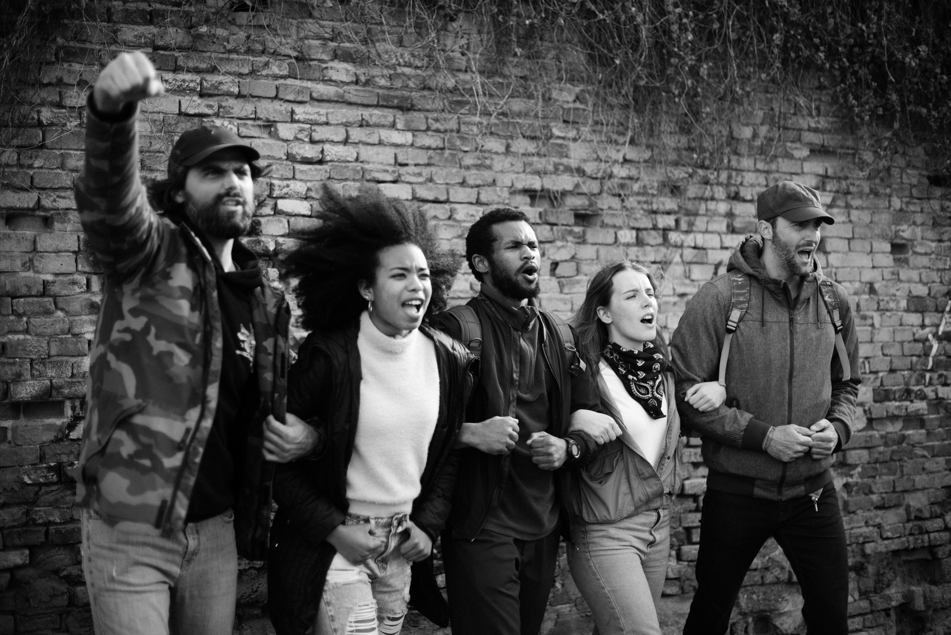
PERSONAL SAFETY AND SUPPORT
  Be mindful of personal triggers when discussing GBV
  It's okay to step back and prioritise your well-being
  Know where to find help and support if needed (list local resources or helplines)

Slide 9
GBV is a serious issue rooted in inequality and power
SUMMARY AND CALL TO ACTION
Everyone has a role in preventing and responding to GBV
Empower yourself and others to create safer communities

Slide 10
QUESTIONS AND DISCUSSION
Open floor for questions
Encourage sharing thoughts and experiences

Slide 11
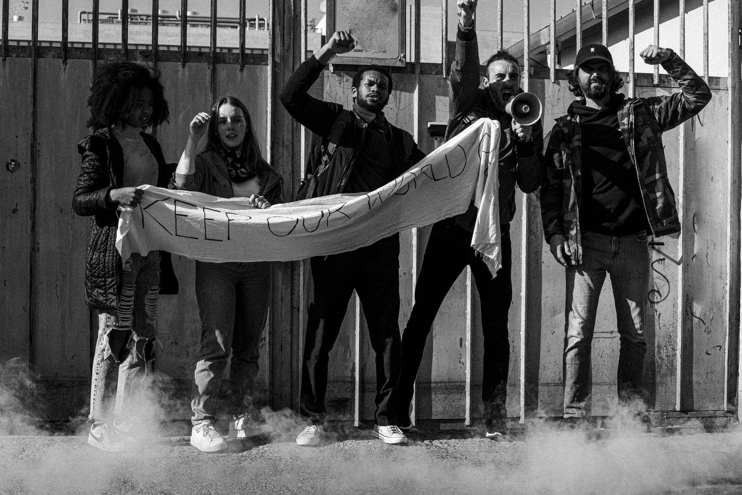

THANK YOU VERY MUCH!
AFRICAN_SKILLED_YOUTH_NG

